Slide 1






Team 5
Microsoft
Azure
Azure DevOps
MOHAMAD AZRI HADIF BIN MOHAMMAD RIZAL (A21EC0054)
MUHAMMAD HASAN BIN CHE ABDULLAH
(A21EC0077)

Slide 2




agenda
Introduction
History
Elements Of Azure DevOps
Setup

Slide 3
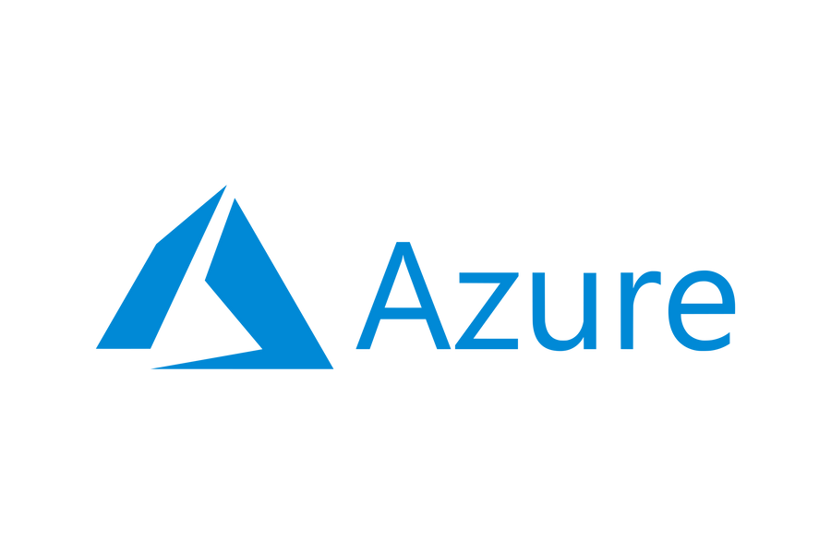


introduction
suite of cloud services; Microsoft Azure is the leaning edge of this revolution. From software as a service (SaaS) to platform as a service (PaaS) and infrastructure as a service (IaaS), Azure’s wide range of services cater to diverse needs empowering businesses to efficiency, scalability, and digital transformation in today's fields.

Slide 4




History
In today's saturated market, creativity is the key to standing out.
Second-Gen
First-gen
Microsoft reform their strategies by renaming their clouds from Windows Azure to Microsoft Azure and making it the pre-eminent way to run Linux Operating System
to enable developers to run the ASP.NET web application and APIs

Slide 5





Third-gen
Present
Microsoft Azure had it in queue as the first cloud service providers to have an end-to-end connected devices stack powered by Event Hub, IoT Hub, Stream Analytics, SQL Database and Power BI
Microsoft Azure with over 600 services has transformed the cloud service landscape
Fourth-Gen
Machine learning and Artificial Intelligence had become the new focus for Microsoft as the cloud began to drift away from OSS and OSS packages, Big Data and IoT towards intelligence

Slide 6

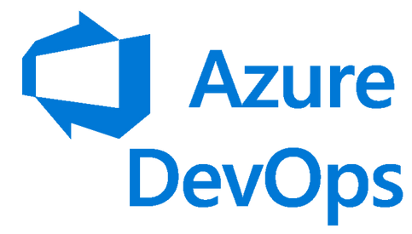







Elements of
Azure Boards
Azure Pipelines
Azure Arctifacts
Azure Repos
Azure Test Plans

Slide 7






Pricing Models
Azure DevOps Server
on-premises version of Azure DevOps
one time license fee
requires CALs (Client Access Licenses) for each user and software assurance
Stakeholder (free)
limited access to Azure DevOps (view, remarks)
typically used for project managers, executives, etc.
can view but cannot edit or create work items (boards, report)

Slide 8
Pricing Models
Azure DevOps Services
Individual
Services
User
Licenses
Open
Source
Azure Pipelines for CI/CD
price depends on host and number of parallel jobs
Azure Artifacts for storage
rate depends on GiB used
Basic Plan
- first 5 users free
- Pipelines, repos,
boards, artifacts
- foundational devops
Basic + Test Plans
- $52/user
- + Test Plans
- UAT, centralised
rePorting, etc.
10 free parallel jobs/month
It provides free access to Azure DevOps services for public projects
build software using Azure DevOps tools.

Slide 9



Setting Up
Azure Account creation
Sign up for an Azure account to access Azure DevOps services and resources.
Creating an organisation
Create an organization in Azure DevOps to manage your projects, teams, and resources.
creating a Project
Set up a project within your organization to organize and track work items, repositories, pipelines, and more.
Creating a team
Establish teams within your project to collaborate on specific tasks, manage permissions, and streamline workflows.

Slide 10
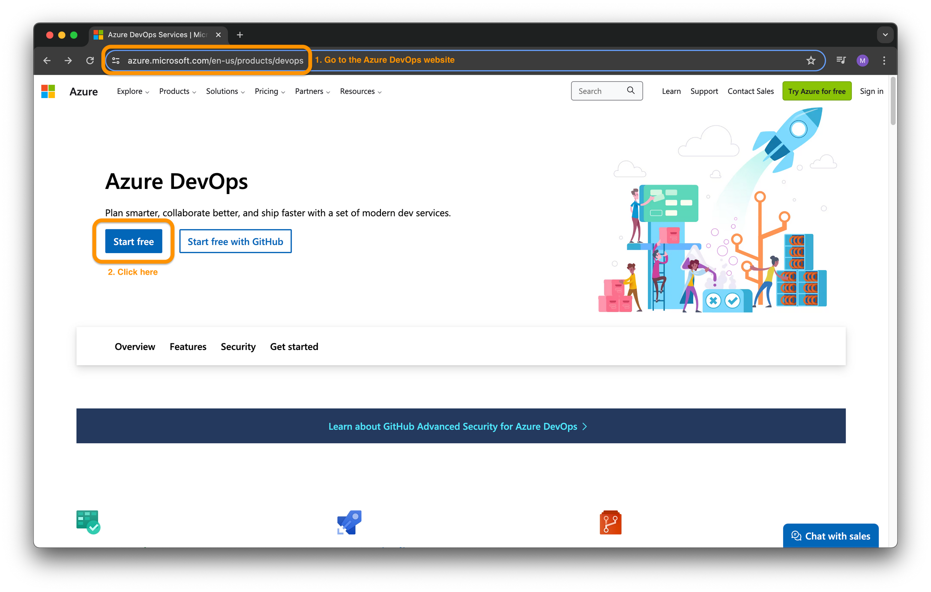

Slide 11
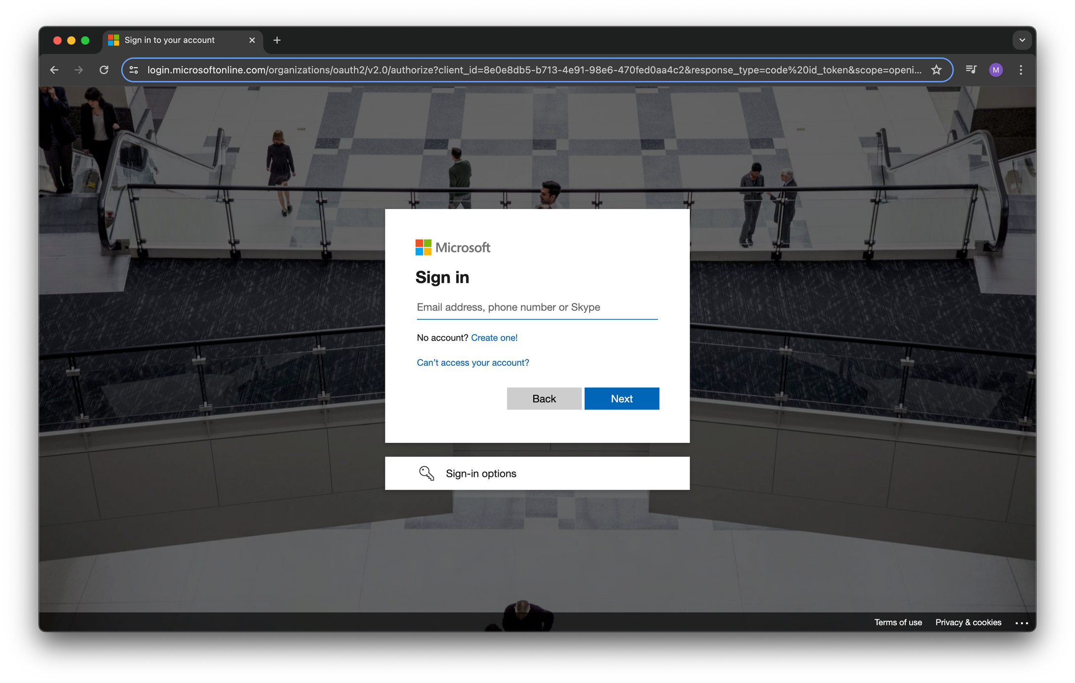

Slide 12
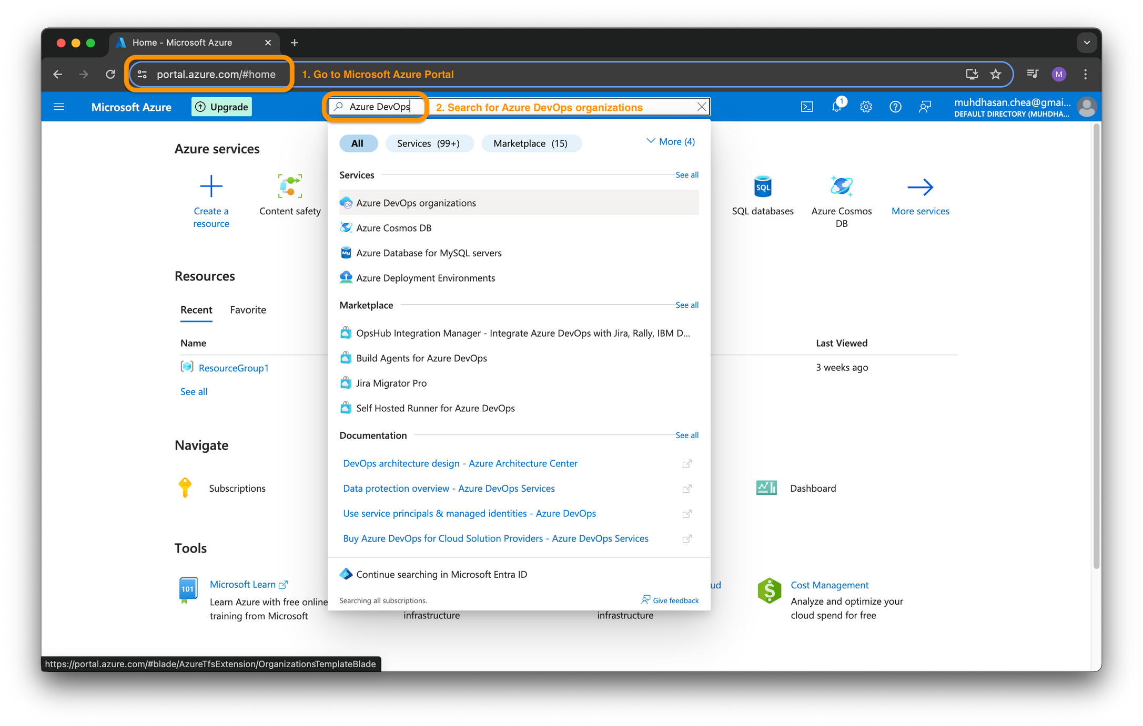

Slide 13
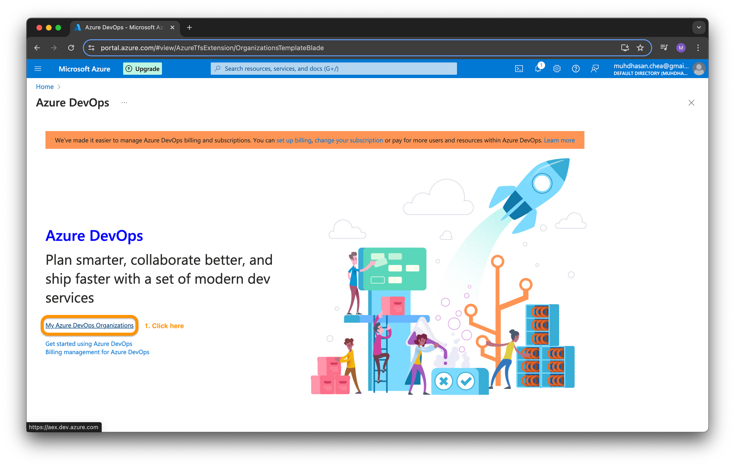

Slide 14
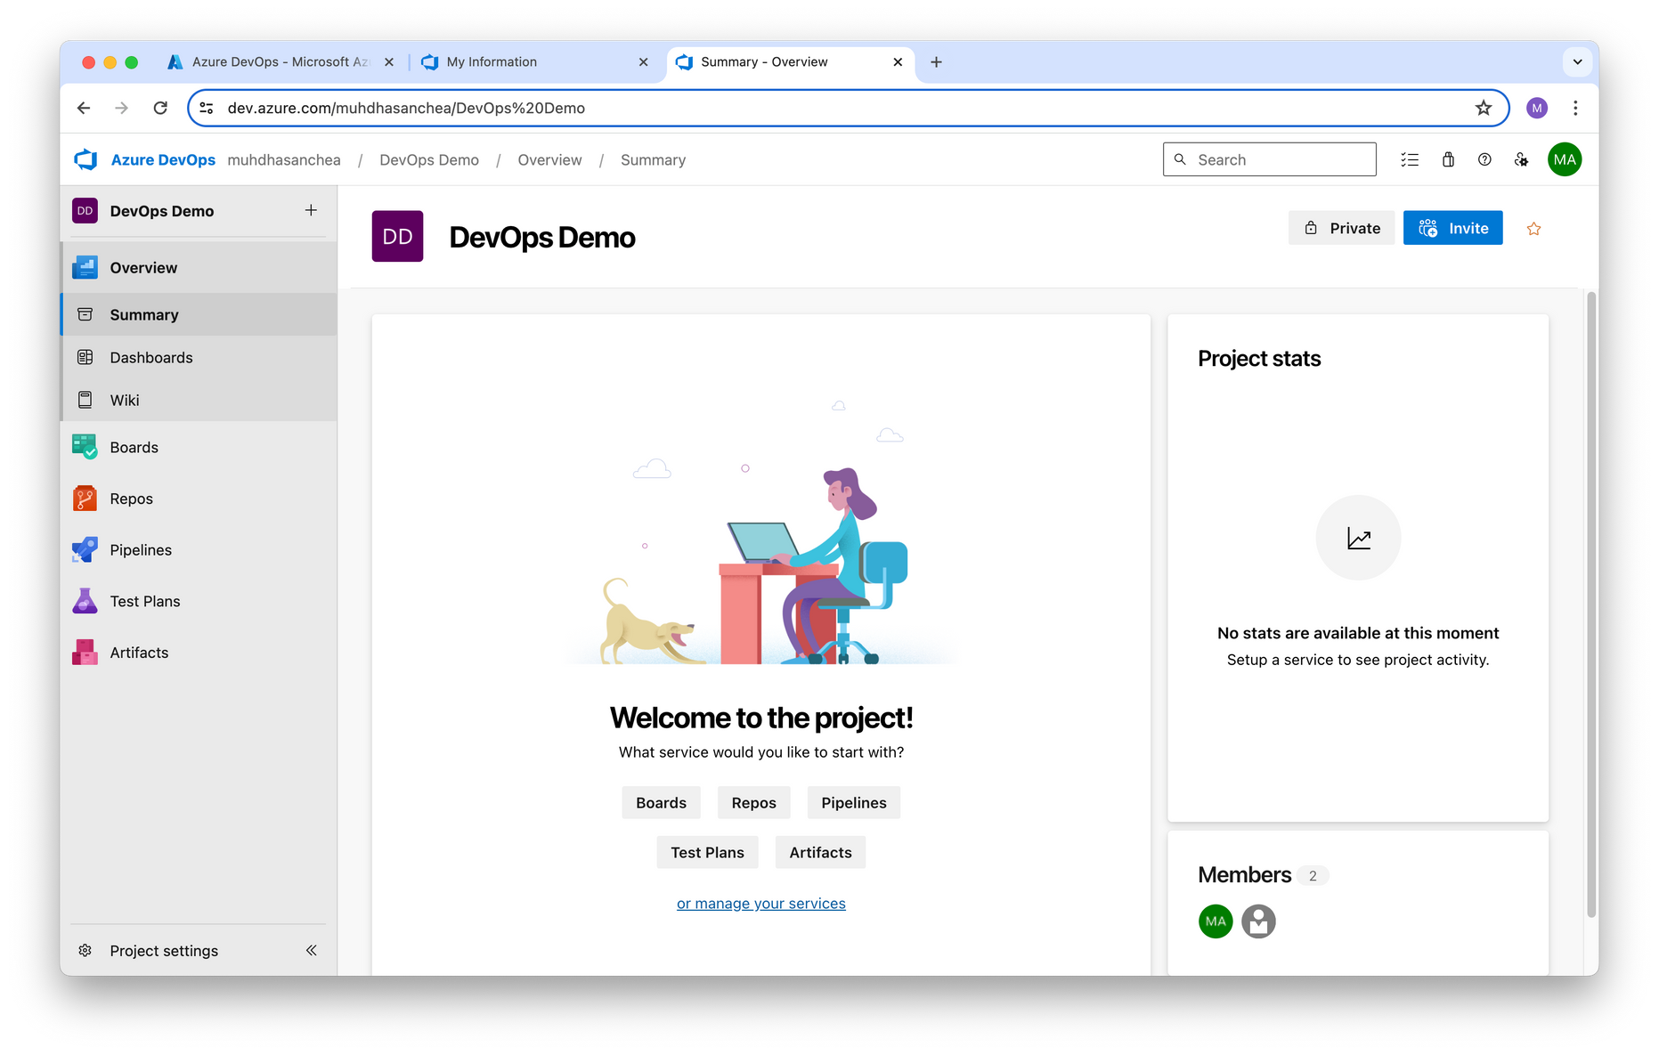
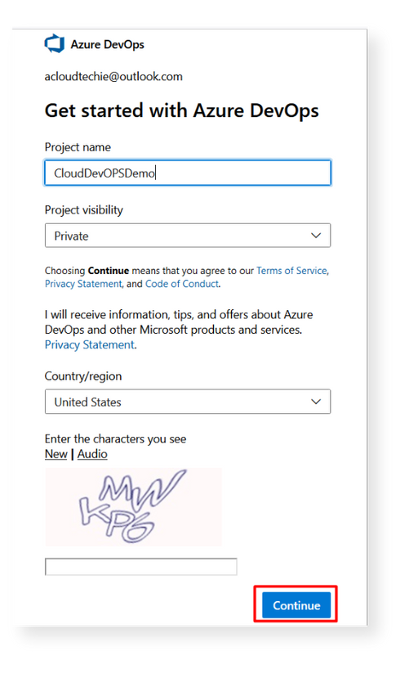

Slide 15

Azure Pipelines
Azure Pipelines automatically builds and tests code projects. It supports all major languages and project types and combines continuous integration, continuous delivery, and continuous testing to build, test, and deliver your code to any destination.
Continuous DeliVery
Continuous delivery automatically deploys and tests code in multiple stages to help drive quality.
Continuous Integration
Continuous integration systems produce deployable artifacts, which include infrastructure and apps.

Slide 16
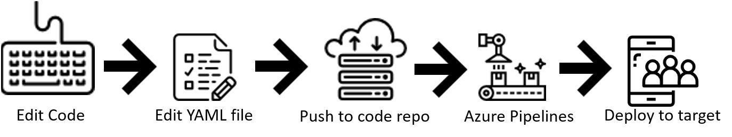
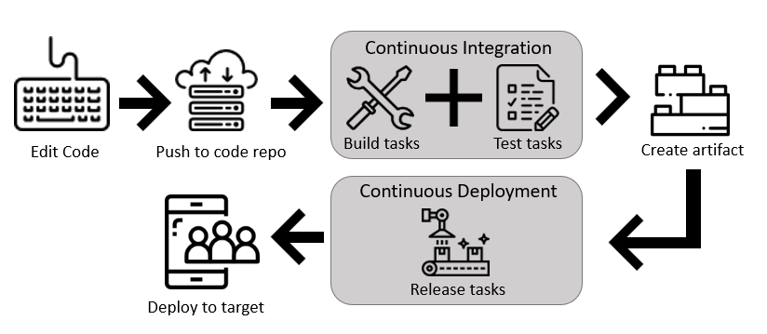
Define pipelines using YAML syntax
Define pipelines using Classic Interface

Slide 17

Create your first pipeline
Prerequisites
A GitHub account
An Azure DevOps organization
An ability to run pipelines on Microsoft-hosted agents.

Slide 18
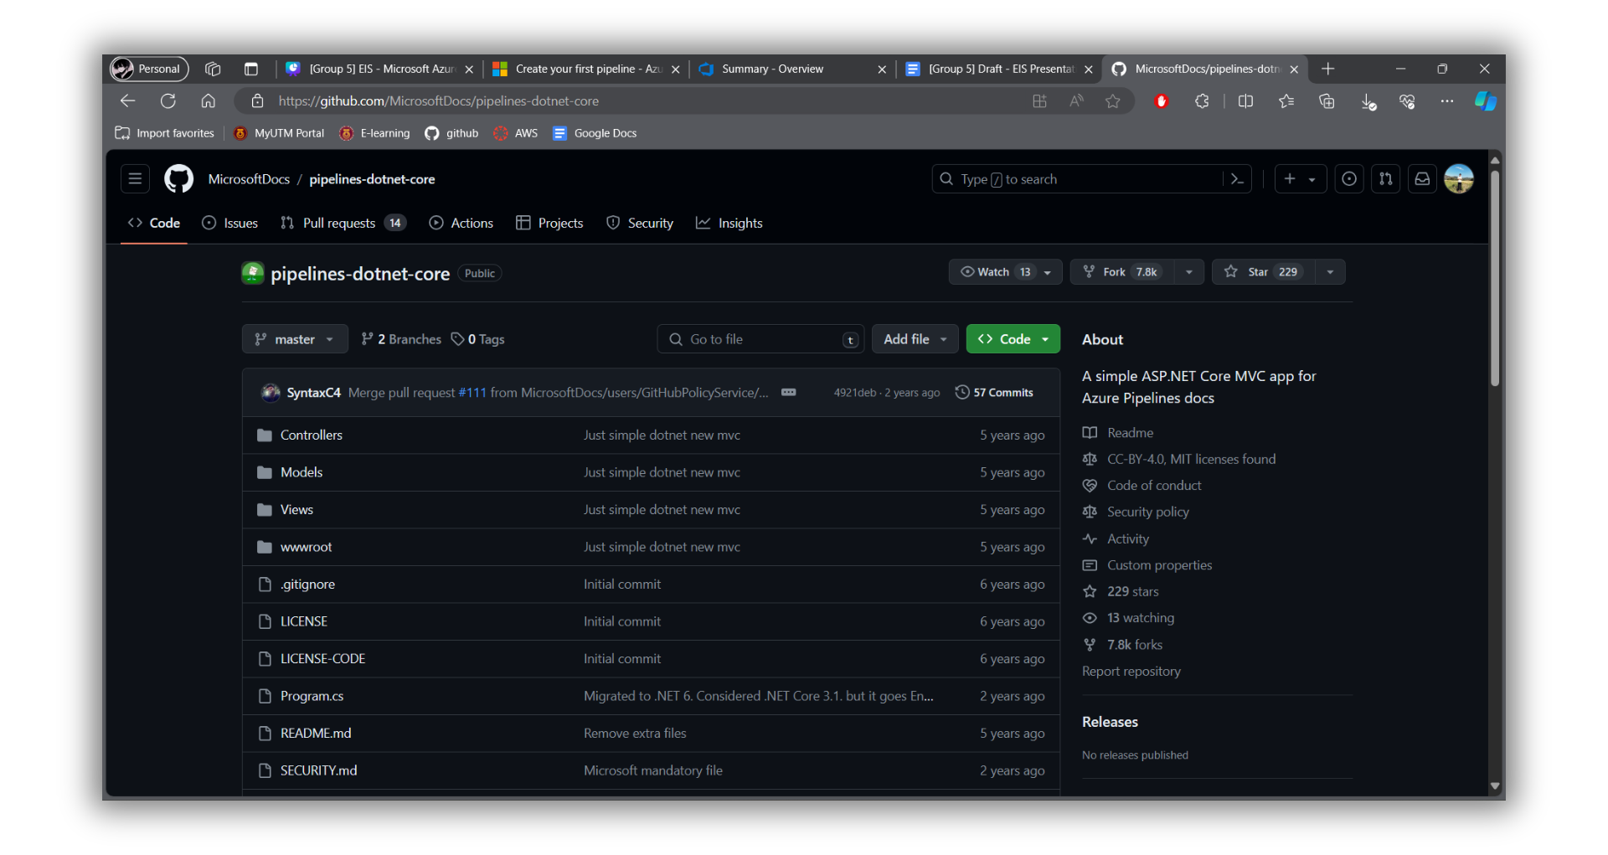
https://github.com/MicrosoftDocs/pipelines-dotnet-core

Slide 19
Sign in to your Azure DevOps organization and go to your project.
Go to Pipelines, and then select New pipeline or Create pipeline if creating your first pipeline.
Do the steps of the wizard by first selecting GitHub as the location of your source code.
You might be redirected to GitHub to sign in. If so, enter your GitHub credentials.
When you see the list of repositories, select your repository.
You might be redirected to GitHub to install the Azure Pipelines app. If so, select Approve & install.
Azure Pipelines will analyze your repository and recommend the ASP.NET Core pipeline template.
When your new pipeline appears, take a look at the YAML to see what it does. When you're ready, select Save and run.
You're prompted to commit a new azure-pipelines.yml file to your repository. After you're happy with the message, select Save and run again.
If you want to watch your pipeline in action, select the build job.
You just created and ran a pipeline that we automatically created for you, because your code appeared to be a good match for the ASP.NET Core template.
You now have a working YAML pipeline (azure-pipelines.yml) in your repository that's ready for you to customize!
When you're ready to make changes to your pipeline, select it in the Pipelines page, and then Edit the azure-pipelines.yml file.

Slide 20
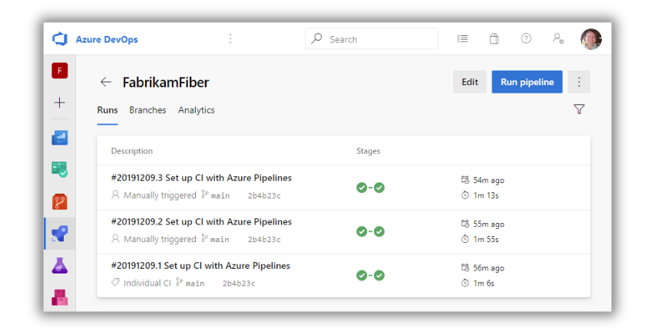

Slide 21
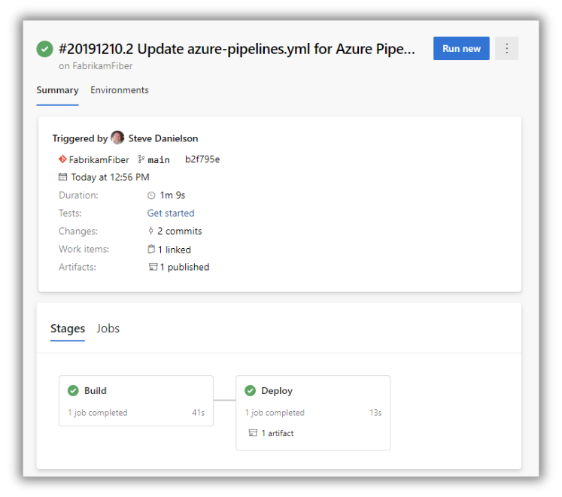

Slide 22
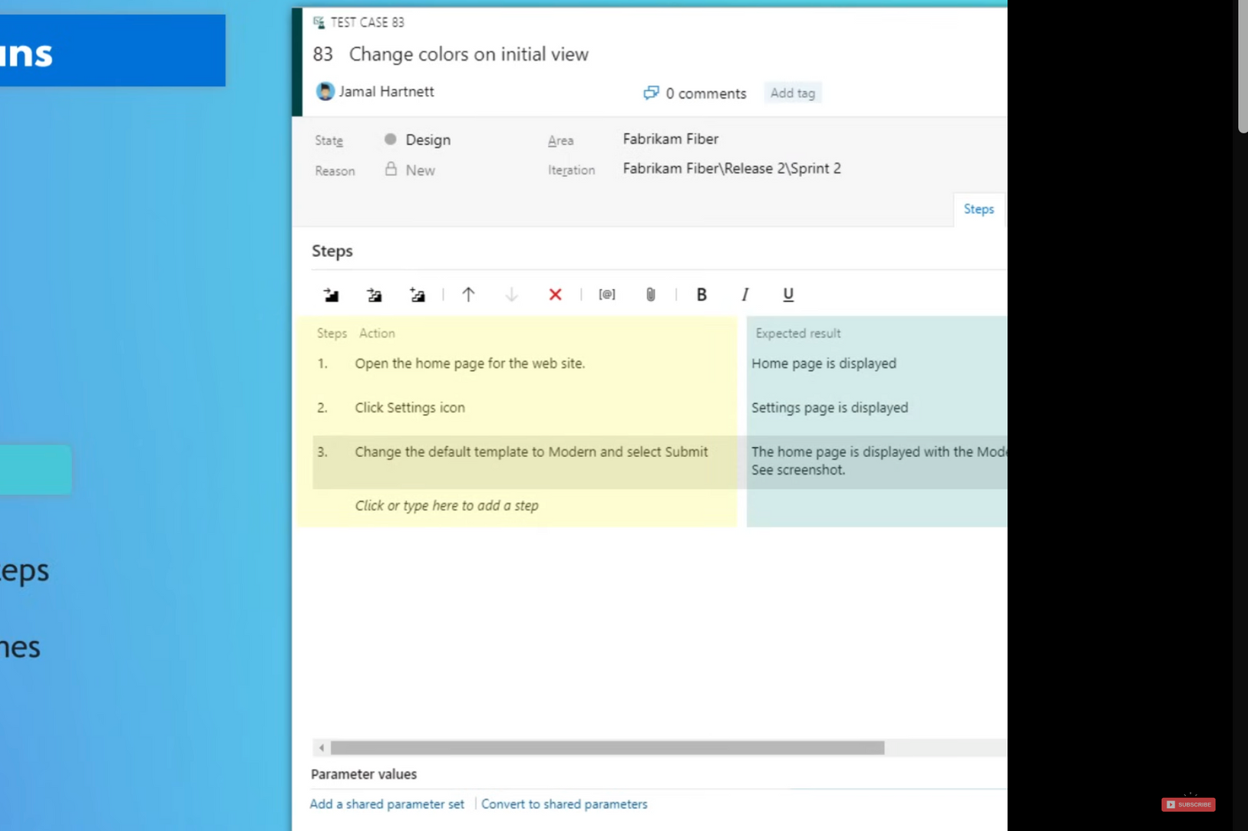
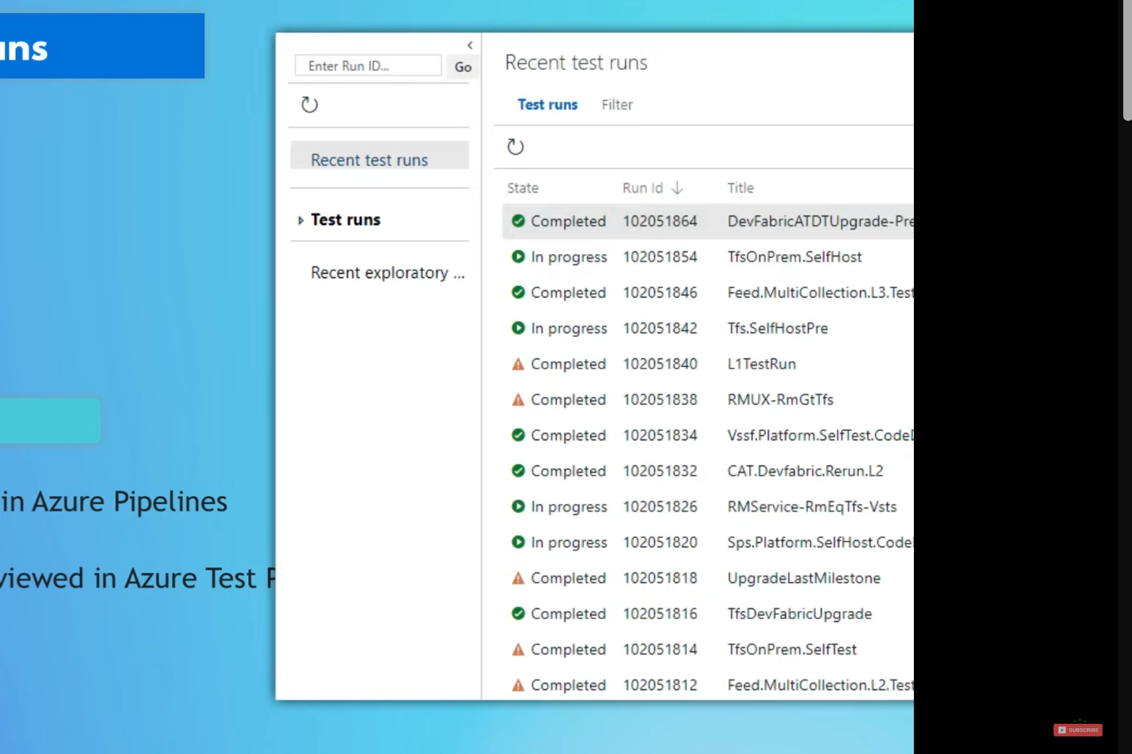

Azure Test Plans
MANUAL TESTS
TEST RUNS

Slide 23
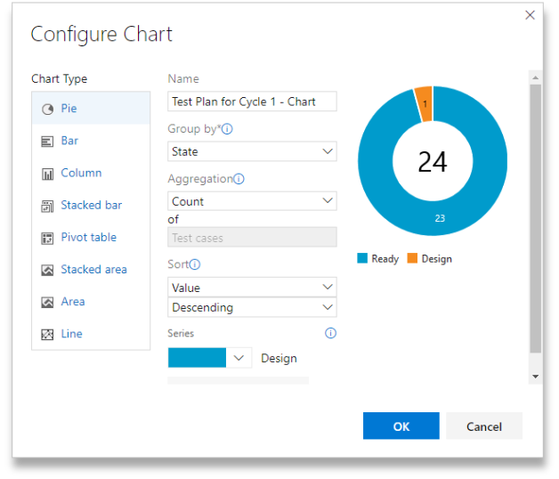
PROGRESS REPORT

Slide 24
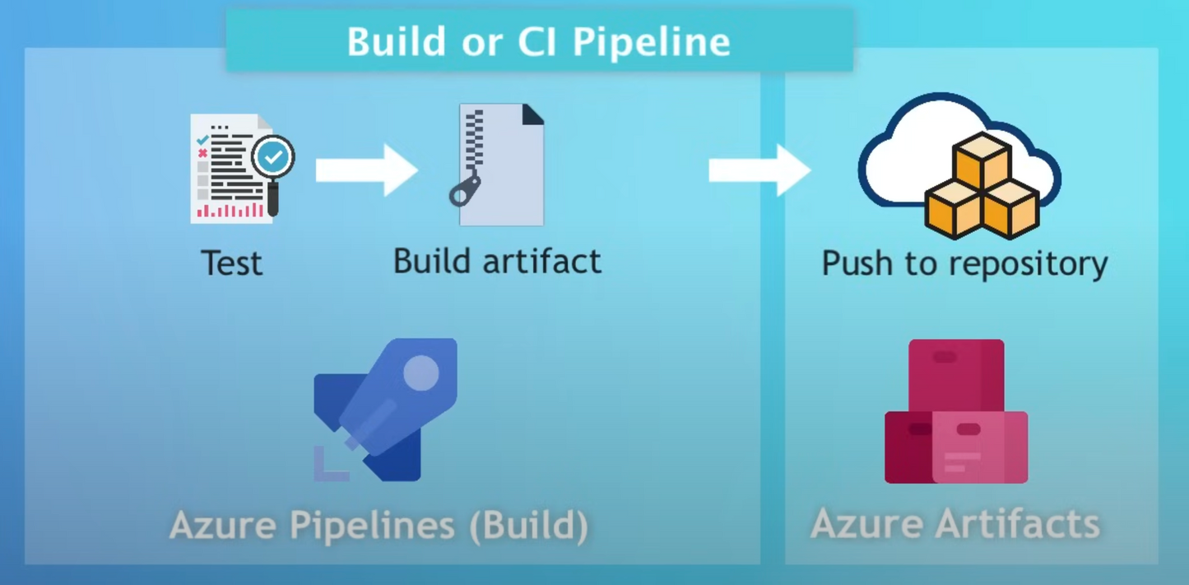
Azure
Artifacts

Slide 25

Thank You
QUESTION?

